Slide 1
Topic modelling and Document Similarity

Slide 2
What is Topic Modeling?
A natural language processing (NLP) technique that uses unsupervised machine learning to analyze large sets of text and identify clusters of similar words
This is known as 'unsupervised' machine learning because it doesn't require a predefined list of tags or training data that's been previously classified by humans.
Used to create structured data from a collection of unstructured data.
It is capable of scanning a set of documents, detecting word and phrase patterns within them, and automatically clustering word groups and similar expressions that best characterize a set of documents.
The data analysis of social media posts, emails, chats, open-ended survey responses and more are not an easy task, when left alone to humans.
AI-powered text analysis uses a wide variety of methods or algorithms to process language naturally, one of which is topic modelling – automatically detect text from topics

Slide 3
What is Topic Modeling?
Topic modelling is recognizing the words from the topics present in the document or the corpus of data. This is useful because extracting the words from a document takes more time and is much more complex than extracting them from topics present in the document.
For example, there are 1000 documents and 500 words in each document. So to process this it requires 500*1000 = 500000 threads.
So when you divide the document containing certain topics then if there are 5 topics present in it, the processing is just 5*500 words = 2500 threads.
This looks simple than processing the entire document and this is how topic modeling has come up to solve the problem and also visualizing things better.

Slide 4
Role of Topic Modeling in Business
An average person generates more than 1.7MB of digital data per second. This number amounts to more than 2.5 quintillion bytes of data per day, of which 80-90% is unstructured.
Consider a scenario where a business employs a single individual to review each piece of unstructured data and segment them based on the underlying topic. It would be an impossible task.
The solution is topic modeling.
Topic Modeling aids Businesses in:
Performing real-time analysis on unstructured textual data
Learn from unstructured data at scale
Build a consistent understanding of data, regardless of its format.

Slide 5
Topic Modeling aids Businesses in:
Performing real-time analysis on unstructured textual data
Learn from unstructured data at scale
Build a consistent understanding of data, regardless of its format.

Slide 6
What are Topics, and How do Topic Models Work?
Topics are the latent descriptions of a corpus (large group) of text. Intuitively, documents regarding a specific topic are more likely to produce certain words more frequently.
For example, the words “dog” and “bone” are more likely to appear in documents concerning dogs, whereas “cat” and “meow” are more likely to be found in documents regarding cats. Consequently, the topic model would scan the documents and produce clusters of similar words.
Essentially, topic models work by deducing words and grouping similar ones into topics to create topic clusters.

Slide 7
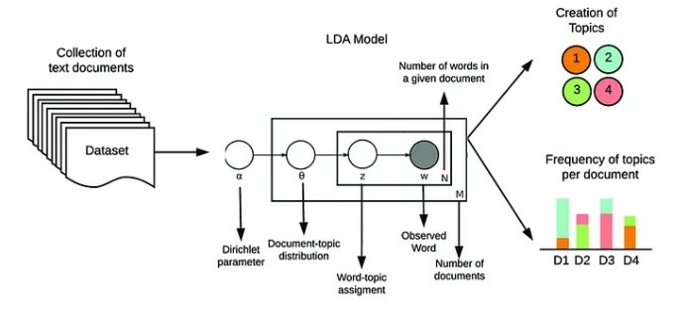
How do Topic Models Work?

Slide 8
Latent Dirichlet Allocation (LDA)
A probabilistic topic model that represents documents as random mixtures of latent topics
It generates topics based on word frequency from a set of documents
Useful for finding a reasonable mixture of topics within a document
LDA works by assuming that each document is a mixture of a small number of topics and that each word in the document is attributable to one of the document's topics.
It then tries to figure out the topics that make up each document and the words that are likely to appear in each topic.

Slide 9
LDA
Can be seen as a matrix factorization technique
Any corpus can be represented as a document-term matrix (DTM)
Rows contains documents and columns contain words
Cell i,j contains the frequency count of word in document
LDA converts DTM into 2 lower dimensional matrices – M1 and M2
M1 is a document-topic matrix with dimensions nXk
M2 is a topic-word matrix with dimension kXm
Where n is the no. of documents
K is the no. of topics
M is the vocabulary size

Slide 10
LDA Computation Steps
Preprocessing
Tokenization, stop word removal, lemmatization.
Dictionary and Corpus Preparation
Create a dictionary of unique words by representing each document as a list of (word, word_id) tuples.
Create BoW for each document or represent each document as a list of (word_id, word_frequency) tuples.
Initialise Parameters
No. of topics, k
Dirichlet hyperparameter for Topic-word Distribution, α
Document-topic Distribution, β
Random Initial Assignment of Topics
Assign each word in each document randomly to one of the topics.

Slide 11


LDA Computation Steps contd
Gibbs Sampling Iteration
For each word,
Calculate topic-word distribution, φ
Calculate document-topic distribution, θ
Calculate conditional probability, P(z/w,d)
Reassign word to new topic based on the computed probability
Topic-Word Probability Calculation (φ):
where n_{k,w​} is the count of word w assigned to topic k,
n_{k}​ is the total count of words assigned to topic k,
V is the vocabulary size, and
β is another Dirichlet hyperparameter.
Document-Topic Probability Calculation (θ):
where n_{d,k}​ is the number of words in document d assigned to topic k,
N_{d} is the total number of words in document d,
K is the number of topics, and
α is a Dirichlet hyperparameter.

Slide 12


Calculation of Overall Probabilities and Reassignment
Overall Probability Calculation
Calculate for each topic z for a given word w in document d
Normalization
Normalize the probabilities for all topics to sum up to 1.
Reassignment
Reassign the word w to a new topic z based on the calculated probabilities.
Iteration Process
Repeat the process for each word in each document.
Update φ and θ
Continue for a fixed number of iterations or until convergence.
Output Topics
After convergence finalise topics
Output φ and θ

Slide 13
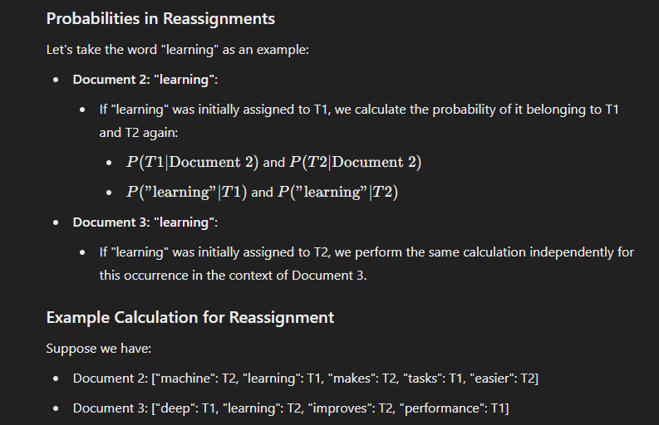
Reassignments

Slide 14
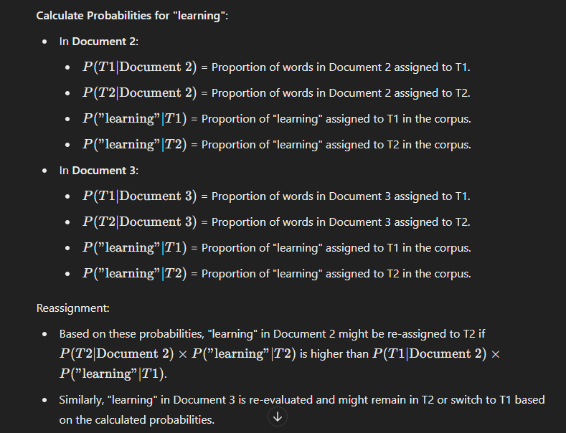
Reassignments - Example

Slide 15
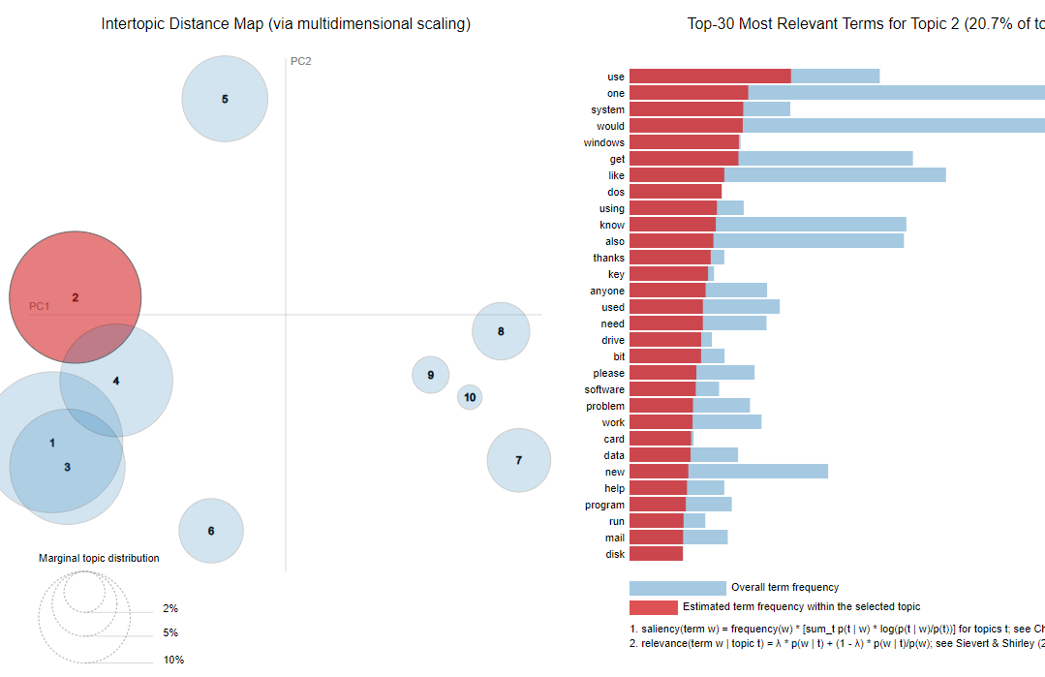
LDA Visualization

Slide 16
Interpretation of LDA Results
Inter-topic Distance Map (Left Side)
Circles Represent Topics: Each circle represents a different topic identified by the LDA model.
Proximity Indicates Similarity: The closer the circles are to each other, the more similar the topics are. Conversely, circles that are far apart represent topics that are less similar.
Circle Size: The size of each circle indicates the proportion of the corpus that the topic represents. Larger circles mean the topic is more prevalent in the dataset.
Top-30 Most Relevant Terms for Topic 1 (Right Side)
Bar Chart: This chart shows the top 30 terms that are most relevant to Topic 1.
Red and Blue Bars: The red bars represent the frequency of the terms within Topic 1, while the blue bars represent the overall frequency of the terms in the entire corpus.
Relevance Metric (λ): The slider at the top allows you to adjust the relevance metric (λ). This metric balances the weight between term frequency within the topic and term frequency across the entire corpus. A lower λ value emphasizes terms that are more unique to the topic, while a higher λ value emphasizes terms that are more frequent overall.

Slide 17

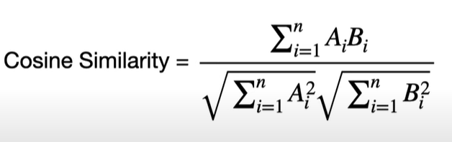
Cosine Similarity
A metric used to measure how similar two non-zero vectors are in a vector space.
Commonly used in text analysis, information retrieval, and various other fields to quantify the similarity between two documents or sets of features.
Defined as the cosine of the angle between two vectors. It is computed using the following formula:

Slide 18
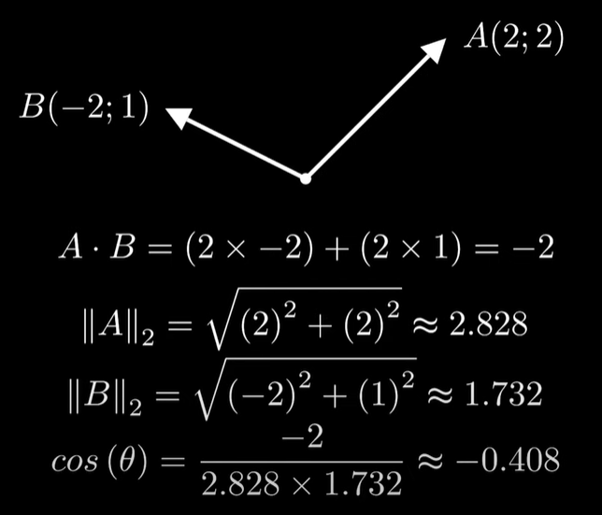
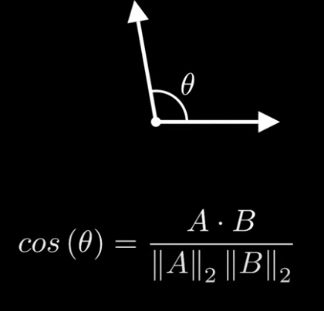
Calculation

Slide 19
Cosine Similarity
Tokenize the Documents: Break each document into individual words (tokens).
Create the Term Frequency (TF) Vectors: Count the occurrences of each word in each document.
Compute the Term Frequency-Inverse Document Frequency (TF-IDF): This step is optional but helps in weighting the terms based on their importance. For simplicity, we'll use TF directly.
Compute the Dot Product: Multiply the TF vectors of the two documents element-wise and sum the results.
Compute the Magnitudes: Calculate the magnitude (Euclidean norm) of each TF vector.
Calculate Cosine Similarity: Divide the dot product by the product of the magnitudes of the two vectors.

Slide 20
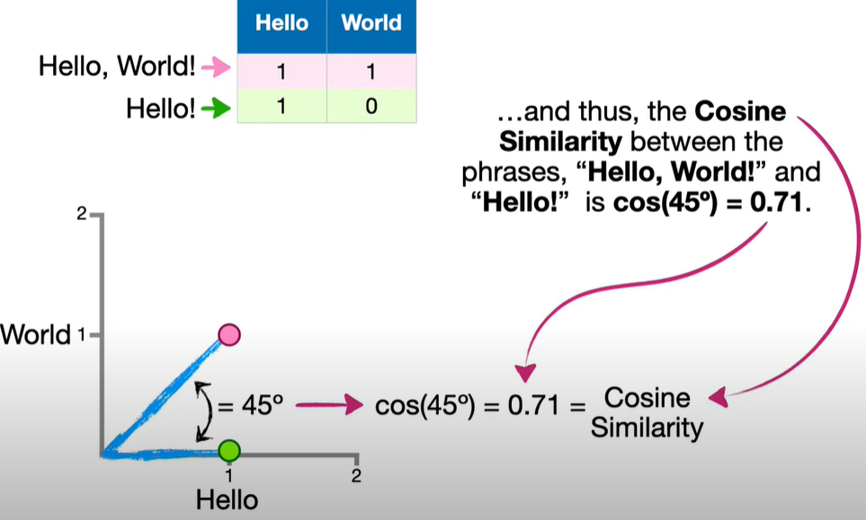
Cosine Similarity

Slide 21
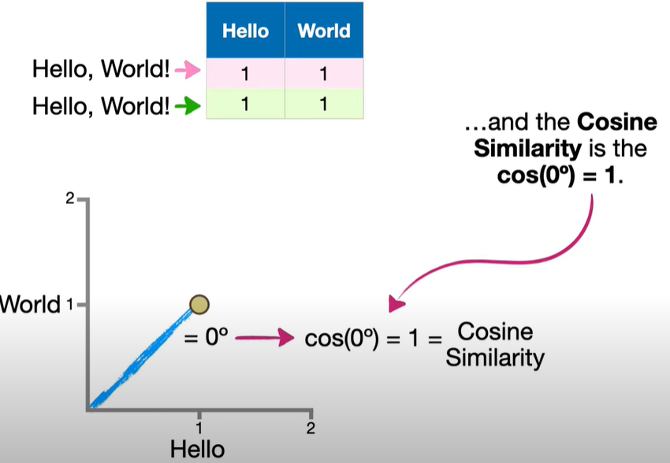
Similar Documents

Slide 22
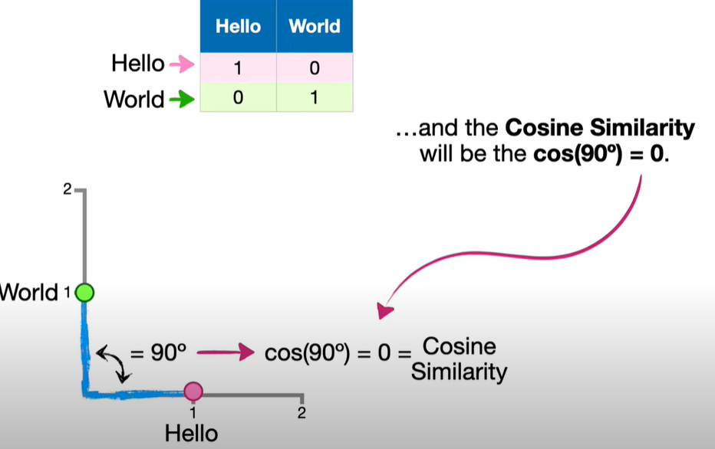
Dissimilar Documents

Slide 23
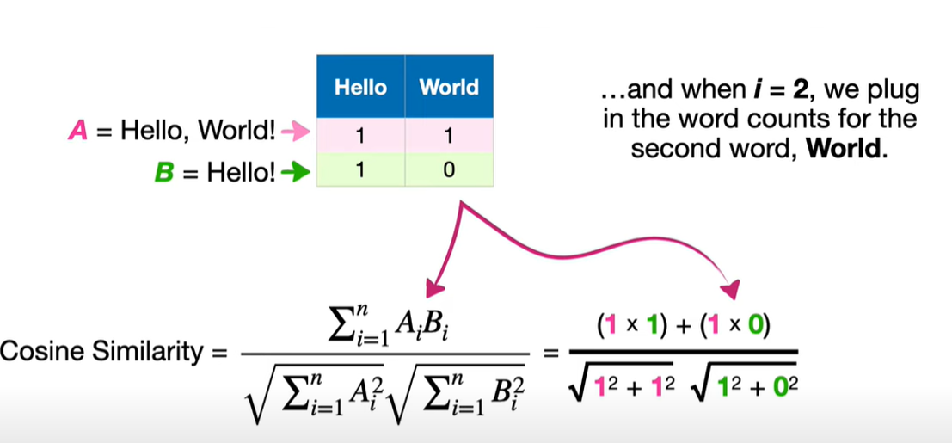
Cosine Similarity Formula

Slide 24
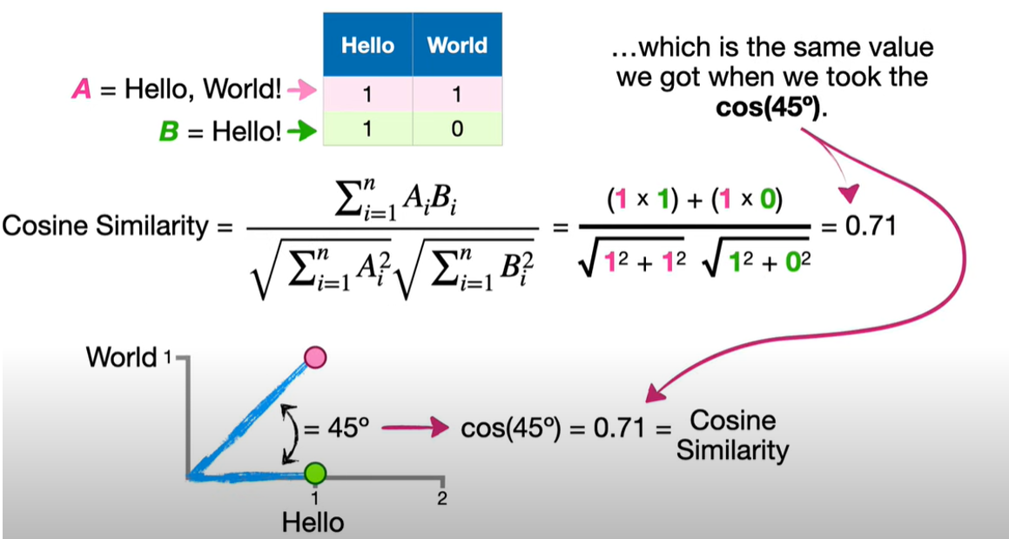

Slide 25
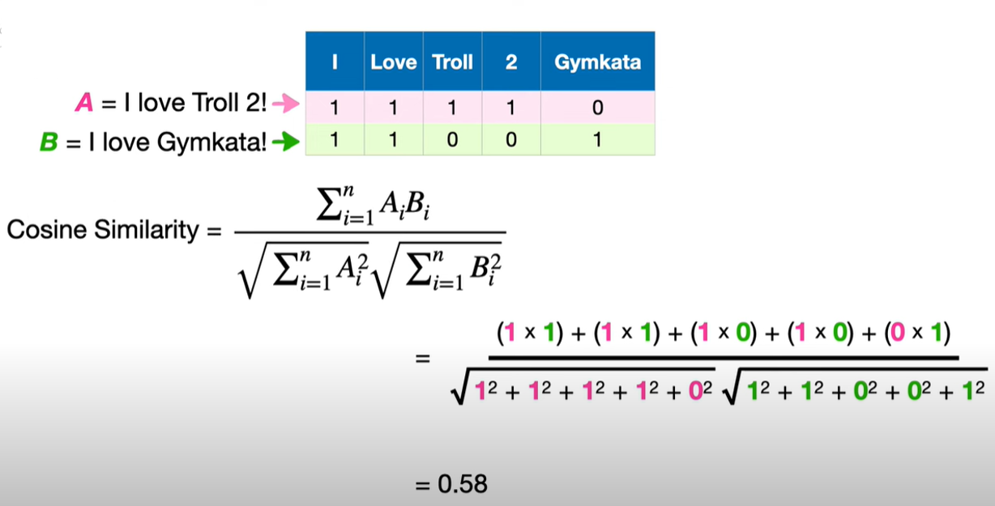

Slide 26
Word Embeddings
Dense vector representations of words in a continuous vector space.
Used to capture the contextual essence of words, their semantic and syntactic similarity, and their relation with other words.
Word embeddings transform textual data, which machine learning algorithms can’t understand, into a numerical form they can comprehend
Enable machine learning models to process textual data.
Dimensionality: Typically ranges from 50 to 300 dimensions.
Similarity: Similar words have vectors that are close together in the vector space.

Slide 27
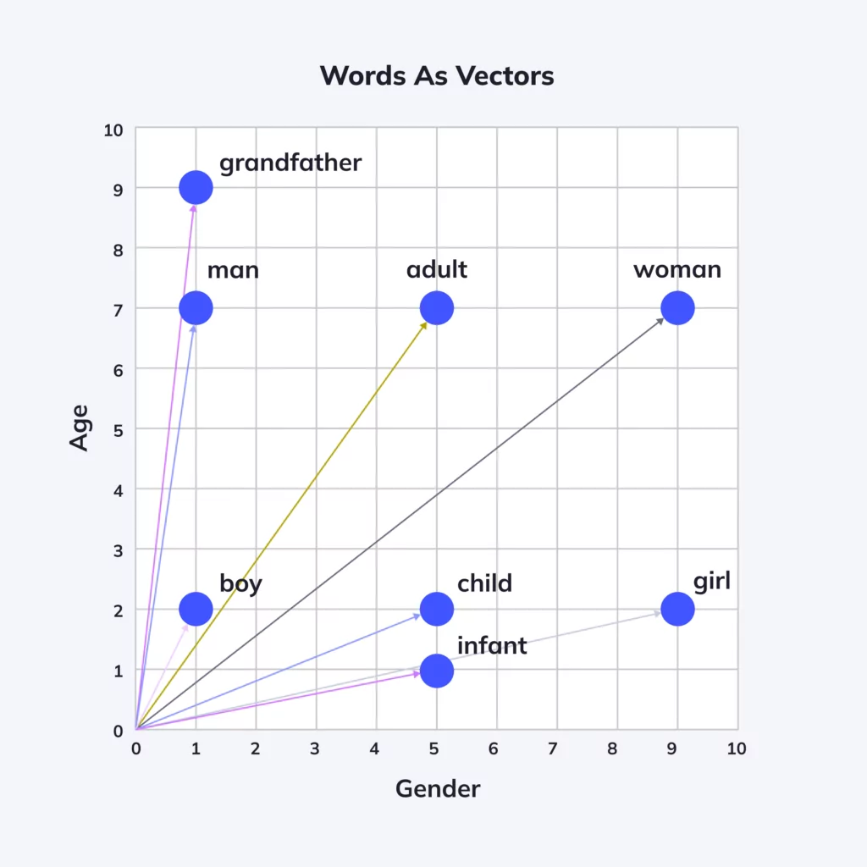
Word Embeddings
The concept of word embeddings is rooted in the idea that the semantics of a word can be represented in terms of its context.
This idea is a departure from traditional bag-of-words models that represent each word as a unique entity, disregarding context and semantics.
Word embeddings, on the other hand, transform words into vectors in a multi-dimensional space, where the spatial distance between words corresponds to their semantic or linguistic similarity.

Slide 28
Why Are Word Embeddings Important?
Capturing semantic meaning: Word embeddings allow us to quantify and categorize semantic similarities between linguistic items. They provide a rich representation of words where the semantics are embedded in the dimensions of the vector space, making it possible for algorithms to understand the relationships between words.
Dimensionality reduction: In contrast to traditional bag-of-words models, where each unique word in the corpus is assigned a unique dimension, word embeddings map words into a lower-dimensional space where the dimensions represent semantic features. This makes word embeddings more computationally efficient.
Handling large vocabularies: Traditional text representation techniques struggle in the face of vast vocabularies, due to the curse of dimensionality and sparsity issues. By representing words as dense vectors, word embeddings can handle large vocabularies efficiently.
Enabling transfer learning: This is a machine learning technique where pre-trained models are used on a new, but related problem. Pre-trained word embeddings learned from large datasets can be leveraged to improve performance on smaller, related tasks. This can significantly reduce the effort of creating new NLP models.

Slide 29
2 Main Categories of Word Embedding Methods
Frequency-based embedding: Embedding methods that utilize the frequency of words to generate their vector representations. Frequency-based methods use statistical measures of how often words appear in the corpus to encode semantic information.
Prediction-based embeddings: Generated by models that learn to predict words from their neighboring words in sentences. These methods aim to position words with similar contexts closely together in the embedding space. They often result in more nuanced word vectors that capture a wide array of linguistic relationships.

Slide 30
Applications of Word Embeddings
Text Classification: Word embeddings transform words into dense vectors, capturing semantic similarities, which help improve the accuracy of classifying text into predefined categories.
Sentiment Analysis: Word embeddings allow sentiment analysis models to understand and differentiate between words with similar meanings but different emotional tones, enhancing sentiment prediction.
Named Entity Recognition (NER): Word embeddings help NER systems recognize entities by capturing the context and semantic relationships of words, making it easier to identify names of people, places, or organizations.
Machine Translation: Word embeddings enable machine translation systems to map words from one language to another by capturing the semantic meaning of words, thus improving translation accuracy.

Slide 31
Frequency-based Embeddings
Term Frequency-Inverse Document Frequency (TF-IDF)
Co-occurrence Matrix

Slide 32
Co-occurrence Matrix
Demonstrates the frequency of terms appearing together in the same block of text, such as a sentence
Co-occurrence Matrix: A matrix that captures the frequency with which words appear together within a specific context window in a corpus.
Rows/Columns: Represent the vocabulary words.
Cells: Contain the co-occurrence counts.

Slide 33
Steps to Create a Co-occurrence Matrix
Corpus Example:
Sentence 1: "The cat sits on the mat"
Sentence 2: "The mat is red“
Step 1: Define the Vocabulary
First, list all the unique words in the corpus to form the vocabulary:
Vocabulary: [The, cat, sits, on, mat, is, red]
Step 2: Define the Context Window
Next, decide on a context window size. For this example, let's use a window size of 2, which means that we’ll look at the two words before and after each target word.
Step 3: Construct the Co-occurrence Matrix
Let’s build the matrix by calculating how many times each word in the vocabulary co-occurs with every other word within the context window.

Slide 34
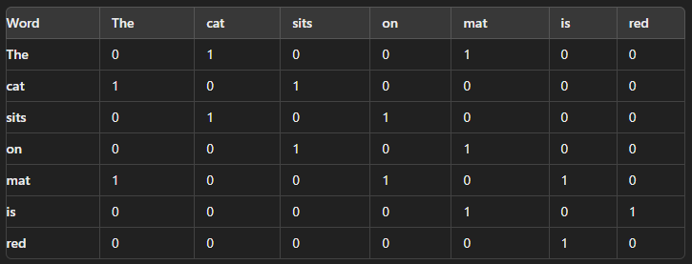
Steps to Create a Co-occurrence Matrix
Step 4: Fill in the Co-occurrence Matrix
Now, based on the context we identified, we fill in the matrix:
Step 5: Interpret the Matrix
The matrix shows how often each word occurs with every other word within the context window.

Slide 35
Prediction-Based Embeddings
Word2Vec (Skip-gram and Continuous Bag of Words): Uses Skip-gram and CBOW (Continuous Bag of Words) models.
FastText: Extends Word2Vec by considering subword information.
GloVe (Global Vectors for Word Representation): Combines global matrix factorization and local context window.
https://swimm.io/learn/large-language-models/5-types-of-word-embeddings-and-example-nlp-applications

Slide 36
Word2Vec
Developed by Google in 2013.
A 2-layer neural network to generate word embeddings given a text corpus
Transforms words into continuous, dense vectors.
Captures semantic and syntactic relationships.
Input is a large corpus of words and output is a vector space
Dimensions of the vector might be 100, 200, 300 etc
Each word is assigned a corresponding vector in the space
Words with same or similar context will be close in the vector space
A computationally effective predictive model for learning word embeddings from raw text

Slide 37
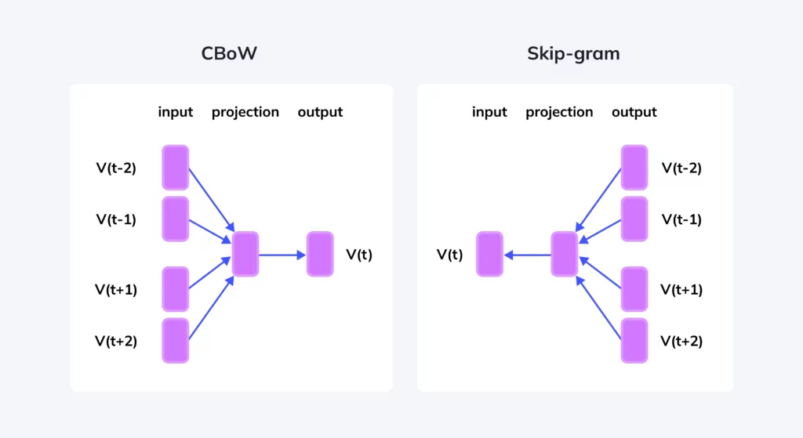
Word2Vec Architecture
Implemented using two architectural designs:
The Continuous Bag of Words (CBOW) Model and
The Continuous Skip-Gram Model.
Both of these are shallow neural networks which map word(s) to the target variable which is also a word(s).
Both of these techniques learn weights which act as word vector representations.
Both models aim to reduce the dimensionality of the data and create dense word vectors

Slide 38
Training Word2Vec Embeddings
Each word in the corpus is initially represented as a high-dimensional vector with random values
The dimension of these vectors is typically around 100-300, and sometimes up to a thousand
As the training progresses, these vectors are updated based on the objective function of the Word2Vec model, which is designed to position vectors of words appearing in similar contexts closer to each other in the vector space.

Slide 39
Weights associated to the Input Vectors
Skip-gram:
The input layer consists of one-hot encoded vectors representing the target word.
The weights between the input layer and the hidden layer form the word embeddings.
Each input word has a vector representation that is learned during training.
CBOW
The input layer consists of one-hot encoded vectors representing the context words.
The hidden layer aggregates these context vectors (often by averaging them).
The weights between the input layer and the hidden layer also form the word embeddings.
The output layer tries to predict the target word.
The weights are adjusted during training to minimize the prediction error.
The final trained weights between the input layer and the hidden layer represent the word embeddings.

Slide 40
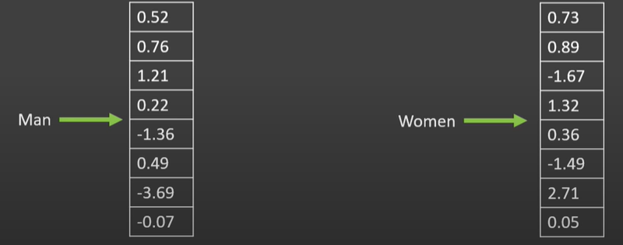
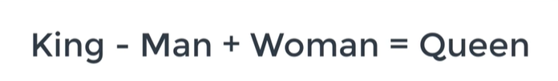
Word2Vec Classic Example

Slide 41
Skip-gram Model
Objective: Predict the context words given a target word.
Mechanism:
Given a word in the sentence, the model tries to predict the words surrounding it within a defined window.
Example: In the sentence "The cat sits on the mat," if the target word is "cat," Skip-gram tries to predict "The" and "sits.“
Strengths:
Works well with smaller datasets.
Handles rare words better as it focuses on individual word relationships.

Slide 42
Skip-gram Model Example
Goal: Predict the context words given a target word.
Example Sentence:
Consider the simple sentence: "The cat sits on the mat."
Step 1: Define Context Window
Context Window Size (C): Let's choose a context window of 2. This means we'll look at 2 words to the left and 2 words to the right of the target word.
Step 2: Generate Training Pairs
For each word in the sentence, we’ll generate pairs of the target word and its context words. Let's create these pairs.
Training Pair: (target word, context word)

Slide 43
Skip-gram Model Example contd…
Target Word: "The“
Context Words: ["cat", "sits"]
Training Pairs: ("The", "cat"), ("The", "sits")
Target Word: "Cat“
Context Words: ["The", "sits", "on"]
Training Pairs: ("Cat", "The"), ("Cat", "sits"), ("Cat", "on")
Target Word: "Sits“
Context Words: ["The", "cat", "on", "the"]
Training Pairs: ("Sits", "The"), ("Sits", "cat"), ("Sits", "on"), ("Sits", "the")
Target Word: "On“
Context Words: ["cat", "sits", "the", "mat"]
Training Pairs: ("On", "cat"), ("On", "sits"), ("On", "the"), ("On", "mat")
Target Word: "The" (again)
Context Words: ["sits", "on", "mat"]
Training Pairs: ("The", "sits"), ("The", "on"), ("The", "mat")
Target Word: "Mat“
Context Words: ["on", "the"]
Training Pairs: ("Mat", "on"), ("Mat", "the")

Slide 44
Skip-gram Model Example contd…
Step 3: Vector Representation (Simplified)
Assign each word a unique index or a simple vector for demonstration.
Step 4: Skip-gram Model Objective
Goal: For each target word, predict the context words.
The model will learn to adjust the word vectors (indices in our case) so that similar words have closer vectors.
Step 5: Training Example (Simplified)
Consider the pair ("Cat", "sits").
The model tries to increase the probability that "sits" is in the context of "cat."
During training, this process adjusts the word vectors (which we represented as indices) to bring "cat" and "sits" closer in the vector space.

Slide 45
Summary of Skip-grams
Input: Target word and context words.
Process: Adjust word vectors so that words appearing together in a context have similar vectors.
Output: Word embeddings that capture the context and semantic relationships between words.
For each target word, pairs are generated with its context words.
These pairs are used by the Skip-gram model to learn word embeddings.
The model adjusts word vectors so that words appearing together in similar contexts have similar embeddings.

Slide 46
Continuous Bag of Words (CBOW) Model
Objective: Predict the target word given context words.
Mechanism:
Given a set of context words, the model tries to predict the target word.
Example: In the sentence "The cat sits on the mat," given the words "The" and "sits," CBOW tries to predict "cat.“
Strengths:
Faster to train due to averaging of context words.
Works well with larger datasets where context is more reliable.

Slide 47
CBOW Example
Predict the target word given the surrounding context words.
Example Sentence:
Let's work with the sentence: "The cat sits on the mat."
Step 1: Define Context Window
Context Window Size (C): We'll use a context window of 2. This means we consider 2 words before and 2 words after the target word.
Step 2: Select a Target Word and Identify Context Words
Let's focus on a specific word in the sentence.
Target Word: “Cat"
Context Words: ["The", “sits", "on"]
The two words before “cat" are "The"
The two words after “cat" are "on" and "the.“

Slide 48
CBOW Example contd
Step 3: Generate Training Instance
Input: The context words ["The", "cat", "on", "the"].
Output: The target word "sits.“
Training Pair: (context words, target word)
Context Word Indices:
Let's assign each word an index for simplicity.
"The" → 1
"Cat" → 2
"Sits" → 3
"On" → 4
"Mat" → 5
Given this, the context word indices for the target word "sits" would be [1, 2, 4, 1] (for "The", "cat", "on", "the").
Training Pair will be: ([1,2,4,1],3)

Slide 49
CBOW Example contd
Step 4: Predict the Target Word (Conceptual)
Model Objective: The CBOW model uses the indices (or vectors) of the context words as input to predict the target word.
Input: [1, 2, 4, 1] (for "The", "cat", "on", "the")
Output: 3 (for "sits")
Learning Process: The model learns to adjust the embeddings (vector representations) of words so that the combination of context word vectors correctly predicts the target word.
Step 5: Full Context Example
Let's generate another training instance from the same sentence.
Target Word: "On"
Context Words: ["cat", "sits", "the", "mat"]
Input: The context word indices are [2, 3, 1, 5] (for "cat", "sits", "the", "mat").
Output: The target word index is 4 (for "on").

Slide 50
CBOW Example contd
Step 6: Model Training (Conceptual)
Process: For each target word in the corpus, CBOW will take the surrounding context words and attempt to predict the target word.
Goal: Adjust the word embeddings so that the model can accurately predict a word based on its surrounding words.
Key Points:
CBOW vs. Skip-gram: While Skip-gram predicts context words given a target word, CBOW predicts the target word given its context.
Training Instances: Each target word in a sentence provides a training instance where context words are used to predict the target word.

Slide 51
Word Embedding Using Word2Vec
https://www.youtube.com/watch?v=viZrOnJclY0&t=872s
https://www.youtube.com/watch?v=UqRCEmrv1gQ
https://swimm.io/learn/large-language-models/what-is-word2vec-and-how-does-it-work
https://neptune.ai/blog/word-embeddings-guide
https://swimm.io/learn/large-language-models/5-types-of-word-embeddings-and-example-nlp-applications

Slide 52
FastText
Extends Word2Vec by considering subword information.
An open-source, lightweight library created by Facebook's AI Research (FAIR) lab for learning word representations and performing text classification.
Traditional word embeddings like Word2Vec treat words as atomic units
FastText considers subword information, which allows it to create more effective embeddings, especially for rare words or morphologically rich languages.
A powerful tool that extends traditional word embedding models by considering character n-grams
Each word is broken down into a series of n-grams with each n-gram having its own vector embedding, and the word is represented as the sum or average of these n-gram embeddings

Slide 53
Key Features of FastText
Subword Information:
FastText represents each word as a bag of character n-grams, meaning that the model also learns representations for character sequences. For example, the word "playing" might be broken down into the character n-grams "pla", "lay", "ayi", and "ing".
This allows the model to understand and generate embeddings even for words it hasn’t seen during training, by combining the embeddings of the subwords.
Handling Out-of-Vocabulary (OOV) Words:
By using subwords, FastText can generate embeddings for words that were not seen during training (out-of-vocabulary words), which is not possible with models like Word2Vec.
Speed:
FastText is designed to be efficient and can be trained on large datasets very quickly. It is faster than many other embedding methods.
Text Classification:
In addition to word embeddings, FastText also supports supervised learning for text classification tasks, making it a versatile tool.
Pre-trained Models:
Facebook provides pre-trained FastText models for many languages, which can be easily used for various NLP tasks.

Slide 54
Working of Fasttext Example Word: "Playing"
Step 1: Define N-Grams
Character n-grams are sequences of characters of a specified length (n). In this example, we'll consider tri-grams (n=3), meaning we break the word into sequences of 3 characters.
Step 2: Generate Character N-Grams
For the word "playing," let's generate all possible tri-grams (subwords). We also include special boundary symbols (< and >) to indicate the start and end of a word.
Word: <playing>
Here, < marks the beginning, and > marks the end.
Now, extract all possible tri-grams:
<pl, pla, lay, ayi, yin, ing, ng>
Step 3: Represent the Word as a Combination of N-Grams
Word Representation: The word "playing" is now represented as a collection of these n-grams:
<pl, pla, lay, ayi, yin, ing, ng>

Slide 55
Working of Fasttext Example Word: "Playing"
Step 4: Embedding of Each N-Gram
Each of these n-grams will have its own embedding (a vector in a high-dimensional space). FastText creates the embedding for the word "playing" by summing (or averaging) the embeddings of all these n-grams.
Example
Let's say, hypothetically, that the embedding for each tri-gram is a 2-dimensional vector:
<pl → [0.1, 0.3], pla → [0.4, 0.2], lay → [0.3, 0.5], ayi → [0.2, 0.4], yin → [0.5, 0.1]
ing → [0.6, 0.7], ng> → [0.3, 0.4]
Step 5: Sum/Average the N-Gram Embeddings
To get the final embedding for "playing," we sum or average the embeddings of all the n-grams.

Slide 56
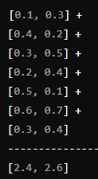
Working of Fasttext Example Word: "Playing"
Sum of Embeddings:
So, the final embedding for the word "playing" would be [2.4, 2.6] after summing.
Average of Embeddings (Optional):
If you take the average instead of the sum, divide each element by the number of n-grams (which is 7 here):
[2.4, 2.6] ÷ 7 = [0.34, 0.37]

Slide 57
Vector Representation of Subwords
Initialization: Subwords are initially assigned random vectors (embeddings).
Training: Vectors are refined during training using backpropagation and gradient descent.
Goal: Similar subwords develop similar vector representations, capturing morphological relationships.

Slide 58
Context and Prediction in FastText
Uses Skip-gram or CBOW architecture to predict context words.
Subword vectors are updated based on their contribution to correct predictions.
Contextual similarity between subwords and surrounding words fine-tunes the embeddings.

Slide 59
Applications of FastText
Word Embeddings: FastText is used to generate dense vector representations of words that can capture syntactic and semantic similarities.
Text Classification: FastText is often used in text classification tasks, such as sentiment analysis or spam detection, due to its speed and accuracy.
Language Modeling: Because it incorporates subword information, FastText is particularly useful in languages with rich morphology, where words often have multiple forms.

Slide 60
Advantages of FastText
Handles Out-of-Vocabulary Words: By generating embeddings for unseen words by combining known subword vectors, FastText is better suited for handling rare words compared to Word2Vec
Efficiency: FastText is computationally efficient, both in terms of speed and memory usage, making it practical for large-scale applications.
Flexibility: It supports both unsupervised learning (for word embeddings) and supervised learning (for text classification).
Captures Morphology: Recognizes prefixes, suffixes, and roots, making embeddings more nuanced.

Slide 61
GloVe (Global Vectors for Word Representation)
Combines global matrix factorization and local context window.
Developed by researchers at Stanford University
GloVe is based on a count-based model
Learns embedding from a global context and derives the semantic relationship between words using word-word co-occurrence matrix
The key idea behind GloVe is to create word vectors by leveraging the global co-occurrence statistics of words in a corpus.

Slide 62
How GloVe Works?
Co-occurrence Matrix
Co-occurrence: GloVe starts by creating a co-occurrence matrix from a large corpus. This matrix counts how often each word appears in the context of every other word.
Context Window: Similar to Word2Vec, GloVe uses a context window (say, 5 words on either side of the target word) to define "context.“
Matrix Example: Suppose we have a corpus with just three words: "ice," "solid," and "water." The co-occurrence matrix might look like:
 | ice | solid | water
ice | 0
solid | 10 | 0
water | 5 | 1 | 0

Slide 63
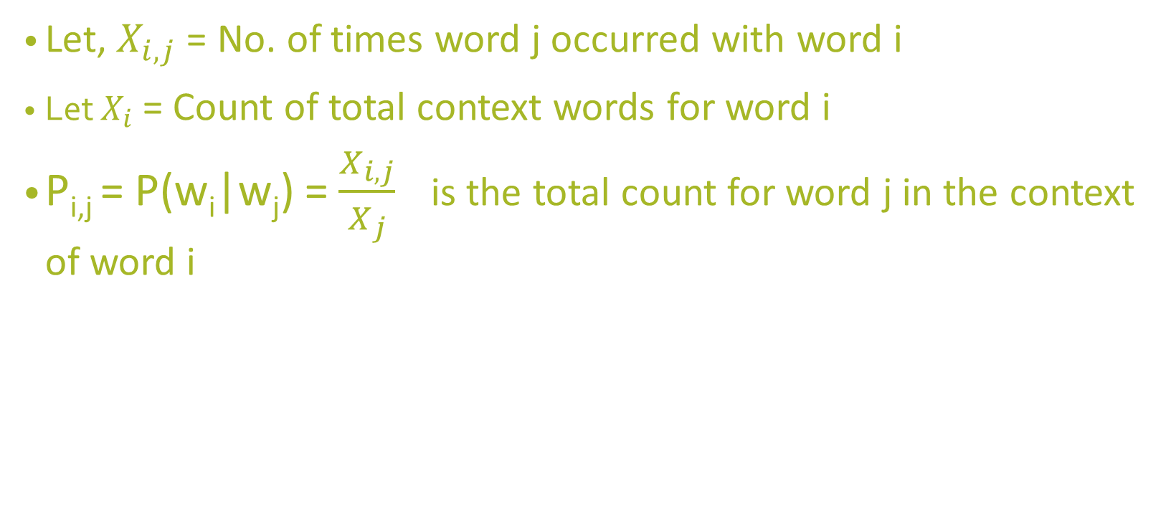
GloVe Probabilities
Let, $X_{i,j}$= No. of times word j occurred with word i
Let $X_{i}$ = Count of total context words for word i
P_{i,j} = P(w_{i}|w_{j}) = $\frac{X_{i,j}}{X_{j}}$ is the total count for word j in the context of word i

Slide 64
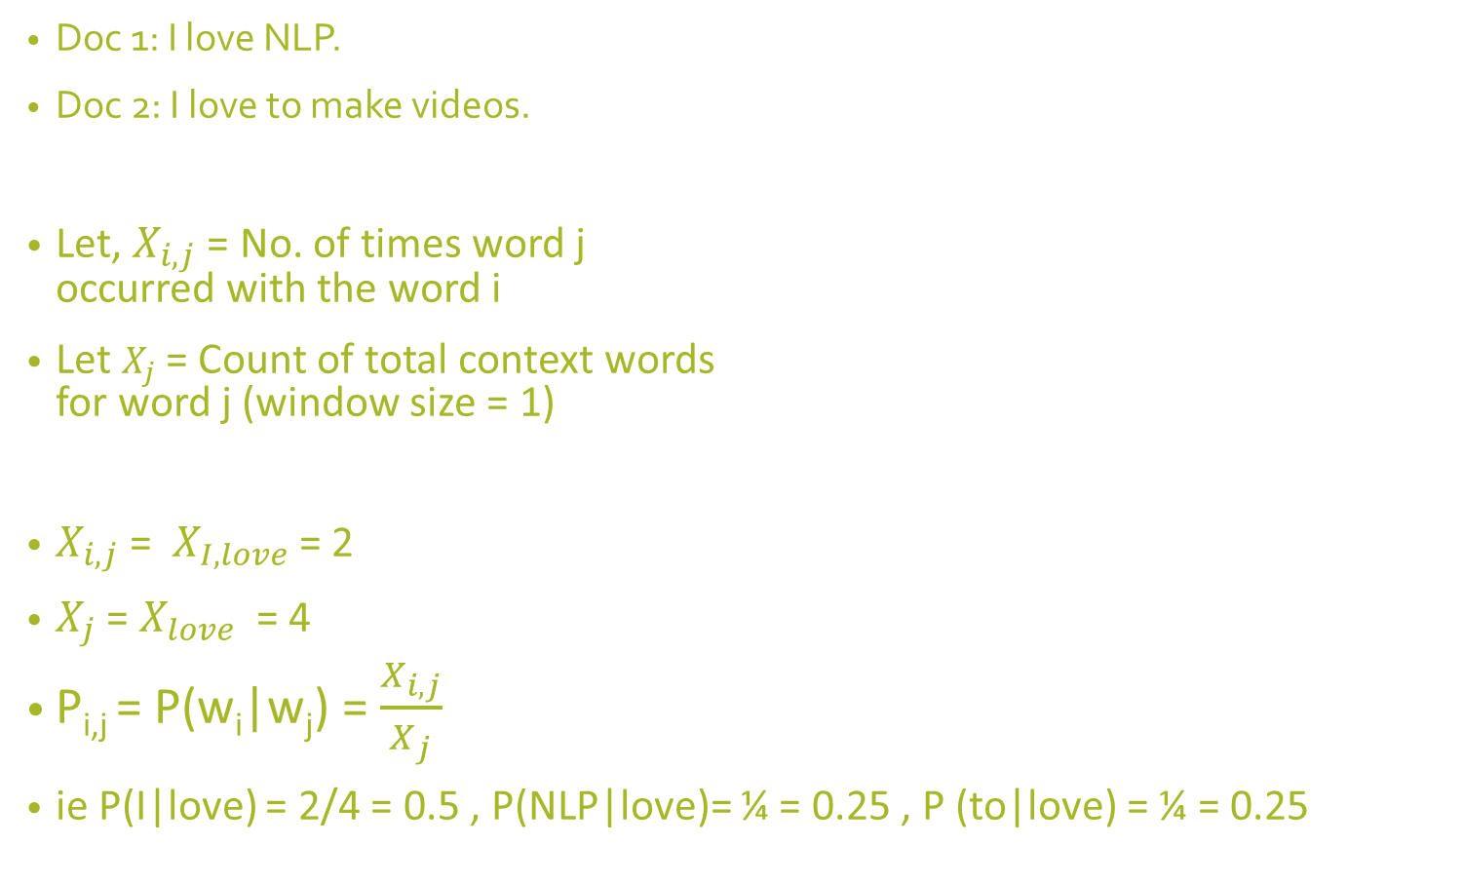
GloVe Example
 | I | love | NLP | to | make | videos
I | 0 | 2 | 0 | 0 | 0 | 0
love | 2 | 0 | 1 | 1 | 0 | 0
NLP | 0 | 1 | 0 | 0 | 0 | 0
to | 0 | 1 | 0 | 0 | 1 | 0
make | 0 | 0 | 0 | 1 | 0 | 1
videos | 0 | 0 | 0 | 0 | 1 | 0
Doc 1: I love NLP.
Doc 2: I love to make videos.
Let, $X_{i,j}$= No. of times word j occurred with the word i
Let $X_{j}$ = Count of total context words for word j (window size = 1)
$X_{i,j}$= $X_{I,love}$= 2
$X_{j}$ = $X_{love}$ = 4
P_{i,j} = P(w_{i}|w_{j}) = $\frac{X_{i,j}}{X_{j}}$
ie P(I|love) = 2/4 = 0.5 , P(NLP|love)= ¼ = 0.25 , P (to|love) = ¼ = 0.25

Slide 65
Co-occurrence Probability Matrix
Doc 1: I love NLP.
Doc 2: I love to make videos.
 | P(w_{i}|I) | P(w_{i}|love) | P(w_{i}|NLP) | P(w_{i}|to) | P(w_{i}|make) | P(w_{i}|videos)
I | 0 | 0.5 | 0 | 0 | 0 | 0
love | 1 | 0 | 1 | 0.5 | 0 | 0
NLP | 0 | 0.25 | 0 | 0 | 0 | 0
to | 0 | 0.25 | 0 | 0 | 0.5 | 0
make | 0 | 0 | 0 | .5 | 0 | 0.25
videos | 0 | 0 | 0 | 0 | 0.5 | 0

Slide 66
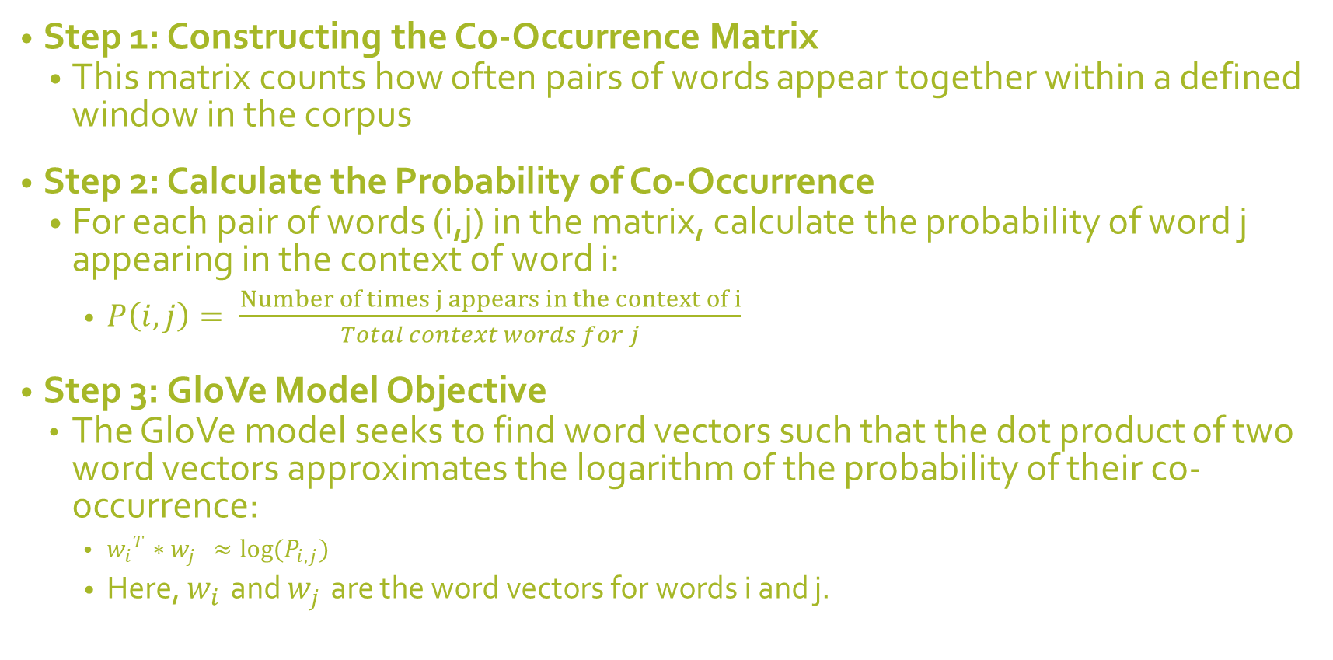
Steps for GloVe Calculation
Step 1: Constructing the Co-Occurrence Matrix
This matrix counts how often pairs of words appear together within a defined window in the corpus
Step 2: Calculate the Probability of Co-Occurrence
For each pair of words (i,j) in the matrix, calculate the probability of word j appearing in the context of word i:
$P\left(i,j\right)= \frac{Number of times j appears in the context of i​}{Total context words for j}$
Step 3: GloVe Model Objective
The GloVe model seeks to find word vectors such that the dot product of two word vectors approximates the logarithm of the probability of their co-occurrence:
${w_{i}}^{T}∗w_{j }≈log⁡(P_{i,j})$
Here, $w_{i }$and $w_{j }$are the word vectors for words i and j.

Slide 67
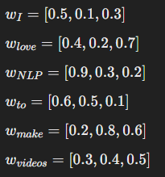
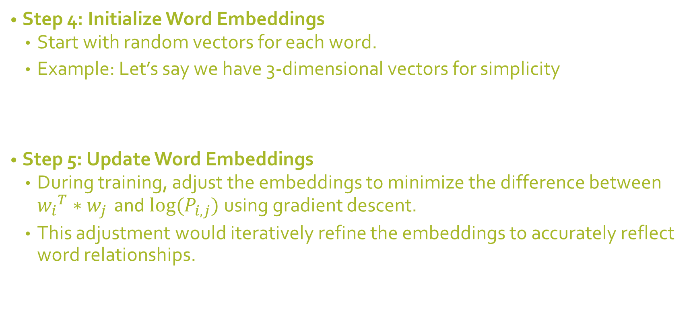
Steps for GloVe Calculation
Step 4: Initialize Word Embeddings
Start with random vectors for each word.
Example: Let’s say we have 3-dimensional vectors for simplicity
Step 5: Update Word Embeddings
During training, adjust the embeddings to minimize the difference between ${w_{i}}^{T}∗w_{j }$and $log⁡(P_{i,j})$ using gradient descent.
This adjustment would iteratively refine the embeddings to accurately reflect word relationships.

Slide 68
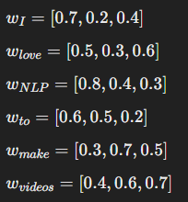
Steps for GloVe Calculation
Step 6: Generate Final Word Embeddings
After training, the word vectors capture the relationships between words based on their co-occurrence.
For simplicity, let’s assume the final word vectors are:
Step 7: Form Document Embeddings
For each sentence, calculate the average of the word vectors
Step 8: Compute Cosine Similarity
To find the similarity between the two sentences, compute the cosine similarity between the 2 words

Slide 69
How to find Document Similarity using word embeddings?
Represent each document as a vector, typically by averaging the word embeddings of the words in the document.
Once the documents are represented as vectors, you can compute the similarity between them using measures like cosine similarity

Slide 70
Steps to Compute Document Similarity:
Step 1: Preprocess the Text
Tokenization: Break the document into individual words.
Lowercasing: Convert all words to lowercase.
Removing Stopwords: Optionally remove common words (like "the", "and") that don't carry much meaning.
Example: "AI is transforming the industry" -> ["ai", "transforming", "industry"]
Step 2: Obtain Word Embeddings
Pre-trained Models: Use models like Word2Vec, GloVe, or FastText.
Get Embeddings: Retrieve the embedding for each word in the document.
Example: "ai" -> [0.2, 0.1, ..., 0.3], "transforming" -> [0.5, 0.3, ..., 0.4]

Slide 71


Steps to Compute Document Similarity:
Step 3: Create a Document Vector
Averaging: Compute the average of the word vectors to get the document vector.
Mathematical Representation:
Step 4: Compute Similarity Between Documents
Cosine Similarity: Commonly used measure; calculates the cosine of the angle between two vectors.
Formula:
Output: Value between -1 and 1, where 1 indicates identical documents, 0 indicates orthogonality (no similarity), and -1 indicates complete dissimilarity.

Slide 72
Example
Step 1: Generate Word Embeddings Using Word2Vec
Sentence 1: "The cat is on the mat"
Sentence 2: "The cat is sleeping"
Step 2: Obtain Word Embeddings
Assume we have a pre-trained Word2Vec model (like Google’s Word2Vec trained on Google News). The model gives us vector embeddings for each word in the vocabulary.
Let's assume the following hypothetical 3-dimensional Word2Vec embeddings for simplicity:
"The": [0.2, 0.1, 0.3]
"cat": [0.4, 0.4, 0.6]
"is": [0.3, 0.2, 0.5]
"on": [0.5, 0.7, 0.1]
"the": [0.2, 0.1, 0.3] (same as "The")
"mat": [0.6, 0.9, 0.2]
"sleeping": [0.7, 0.6, 0.5]

Slide 73
Example contd
Step 3: Compute Sentence Embeddings
To get the document embedding (or sentence embedding), we typically average the embeddings of the words in the sentence.
Sentence 1: "The cat is on the mat"
Word vectors:
"The" = [0.2, 0.1, 0.3]
"cat" = [0.4, 0.4, 0.6]
"is" = [0.3, 0.2, 0.5]
"on" = [0.5, 0.7, 0.1]
"the" = [0.2, 0.1, 0.3]
"mat" = [0.6, 0.9, 0.2]

Slide 74

Example contd.
Sentence embedding (mean of the word vectors):
Sentence 1 Embedding=1/6*([0.2,0.1,0.3]+[0.4,0.4,0.6]+[0.3,0.2,0.5]+[0.5,0.7,0.1]+[0.2,0.1,0.3]+[0.6,0.9,0.2])
Adding them together:
=[2.2,2.4,2.0]
Then averaging (divide by 6):

Slide 75

Example contd.
Sentence 2: "The cat is sleeping"
Word vectors:
"The" = [0.2, 0.1, 0.3]
"cat" = [0.4, 0.4, 0.6]
"is" = [0.3, 0.2, 0.5]
"sleeping" = [0.7, 0.6, 0.5]
Sentence embedding (mean of the word vectors):
Sentence 2 Embedding=1/4*([0.2,0.1,0.3]+[0.4,0.4,0.6]+[0.3,0.2,0.5]+[0.7,0.6,0.5])
Adding them together:
=[1.6,1.3,1.9]
Then averaging (divide by 4):

Slide 76
Example contd.
Step 4: Calculate Cosine Similarity
Cosine Similarity= A.B/||A||.||B||
A and B are the sentence embeddings.
A⋅B is the dot product of the two vectors.
∥A∥ and ∥B∥ are the magnitudes (norms) of the vectors.
Sentence 1 Embedding: [0.367, 0.4, 0.333]
Sentence 2 Embedding: [0.4, 0.325, 0.475]
Find the cosine similarity using the above formula.

Slide 77
Summary of Document Similarity
Step 1: Gather word embeddings for each word in the sentences using a pre-trained Word2Vec, Fasttext or GloVe model.
Step 2: Compute the average of these embeddings to get the sentence embedding for each sentence.
Step 3: Calculate cosine similarity between the sentence embeddings to determine how similar the sentences are.

Slide 78
Example Applications of Word Embeddings
Text Classification and Sentiment Analysis
Machine Translation
Information Retrieval and Search
Named Entity Recognition
Text Summarization

Slide 79
Github Link
https://github.com/Reginasabs/DocSimilarity

